Slide 1
Remaining types of Dimensions

Slide 2
8. Slowly Changing Dimension Type
The "Slowly Changing Dimension" is a common problem particular to data warehousing. In a nutshell, this applies to cases where the attribute for a record varies over time.

Slide 3
Scenario of SCD
John is a customer with ABC Inc. company.
For the customer related details there is a table with columns CustID, CustName and CustCity.
Initially John’s city is Delhi.
So originally the record of John looked like this:
CustID | CustName | CustCity
C1 | John | Delhi

Slide 4
After some days John moved from Delhi to Mumbai.
Now how should ABC Inc. Company modify its customer table to reflect this change??
This is the "Slowly Changing Dimension" problem.

Slide 5
Type 1 SCD
In Type 1 Slowly Changing Dimension, the new information simply overwrites the original information. In other words, no history is kept.
In our example, recall we originally have the following table:
CustID | CustName | CustCity
C1 | John | Delhi

Slide 6
Type 1 SCD
After John moved from Delhi to Mumbai, the new information replaces the new record, and we have the following table:
CustID | CustName | CustCity
C1 | John | Mumbai

Slide 7
Advantages of Type 1 SCD
This is the easiest way to handle the Slowly Changing Dimension problem, since there is no need to keep track of the old information.
Disk space required will be less.

Slide 8
Disadvantages of Type 1 SCD
All history is lost. By applying this methodology, it is not possible to trace back in history. For example, in this case, the company would not be able to know that John lived in Delhi before.

Slide 9
Usage of Type1 SCD
About 50% of the time.
In RDBMS model or OLTP systems by using simple “Update” SQL statement we achieve Type 1 SCD !

Slide 10
When to use Type 1 SCD
Type 1 slowly changing dimension should be used when it is not necessary for the data warehouse to keep track of historical changes.

Slide 11
Type 2 SCD
In Type 2 Slowly Changing Dimension, a new record is added to the table to represent the new information. Therefore, both the original and the new record will be present. The new record gets its own primary key.
In our example, recall we originally have the following table:
CustID | CustName | CustCity
C1 | John | Delhi

Slide 12
Type 2 SCD
After John moved from Delhi to Mumbai, we add the new information as a new row into the table:
CustID | CustName | CustCity
C1 | John | Delhi
C1 | John | Mumbai

Slide 13
Type 2 SCD
Identification of old and new rows can be done by:
Start Date & End Date Columns
Or
2. One column having Status as Yes or No

Slide 14
Type 2 SCD
Dates to Identify old row (s) & current row
CustID | CustName | CustCity | Start Date | End Date
C1 | John | Delhi | 1-Jan-2013 | 15-Feb-2014
C1 | John | Mumbai | 16-Feb-2014
Null means current row

Slide 15
Type 2 SCD
Status (having Yes & No) to Identify old row (s) & current row
CustID | CustName | CustCity | Status
C1 | John | Delhi | No
C1 | John | Mumbai | Yes
Yes means current row

Slide 16
Advantages of Type 2 SCD
This allows us to accurately keep all historical information

Slide 17
Disadvantages of Type 2 SCD
This will cause the size of the table to grow fast. In cases where the number of rows for the table is very high to start with, storage and performance can become a concern.
This necessarily complicates the ETL process.
It needs the record identifier column like Identity property, Sequence object or Auto number additionally to identify records of same customer id.

Slide 18
Usage of Type 2 SCD
About 50% of the time
In OLAP
This style can get used also in old Flat File Systems or in spreadsheets kind of data format.

Slide 19
When to use Type 2 SCD
Type 2 slowly changing dimension should be used when it is necessary for the data warehouse to track historical changes.

Slide 20
Type 3 SCD
In Type 3 Slowly Changing Dimension, there will be two columns to indicate the particular attribute of interest, one indicating the original (or previous) value, and one indicating the current value.
There will also be a column that indicates when the current value becomes active.
In our example, recall we originally have the following table:
CustID | CustName | CustCity
C1 | John | Delhi

Slide 21
Type 3 SCD
To accommodate Type 3 Slowly Changing Dimension, we will now have the following columns:
Customer Key
Name
Original City
Current City
Effective Date

Slide 22
After John moved from Delhi to Mumbai, the original information gets updated, and we have the following table (assuming the effective date of change is January 15, 2010):
CustID | CustName | Original City | Current City | Effective Date
C1 | John | Delhi | Mumbai | 15-Jan-2010

Slide 23
Advantages of Type 3 SCD
This does not increase the size of the table, since new information is updated.
This allows us to keep some part of history.

Slide 24
Disadvantages of Type 3 SCD
Type 3 will not be able to keep all history where an attribute is changed more than once.
For example, if John later moves to Bangalore on December 15 2010, the Delhi information will be lost.

Slide 25
Usage of Type 3 SCD
Type 3 is rarely used in actual practice.

Slide 26
When to use Type 3 SCD
Type III slowly changing dimension should only be used when it is necessary for the data warehouse to track historical changes, and when such changes will only occur for a finite number of time.

Slide 27
Solutions of first 3 types of SCD
There are in general three ways to solve this type of problem, and they are categorized as follows:
Type 1: The new record replaces the original record. No trace of the old record exists.
Type 2: A new record is added into the customer dimension table. Therefore, the customer is treated essentially as two people.
Type 3: The original record is modified to reflect the change along with the old value .

Slide 28
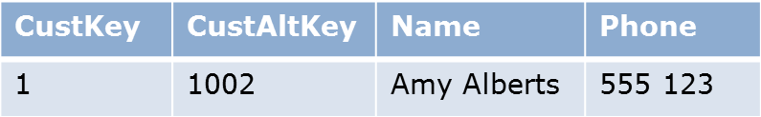
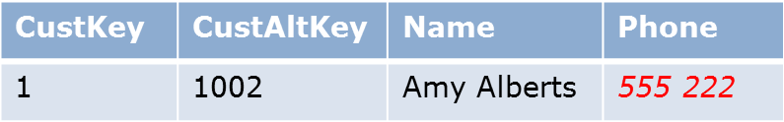
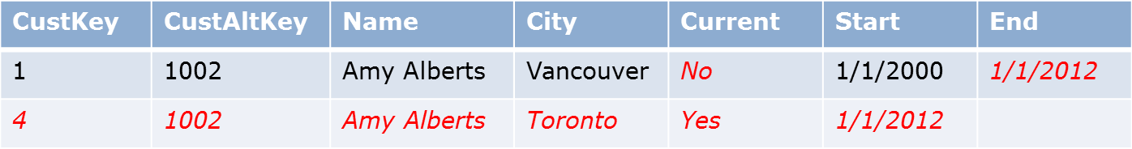
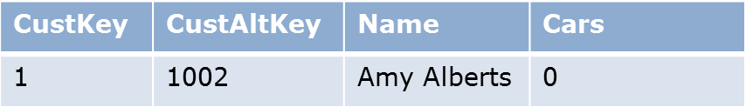
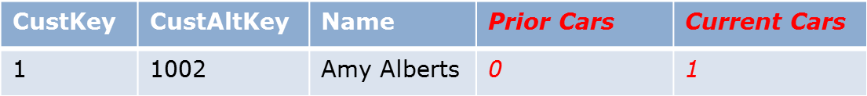
First 3 SCDs
Type 1
Type 2
Type 3
Notes:
The slide shows a before and after representation of three tables. One shows an example of a type 1 change, one shows a type 2 change, and the other shows a type 3 change.
20467B
3: Designing a Data Warehouse

Slide 29
Type 4 SCD
In Type 4 SCD all the changes are stored in a History Table. Latest value only saved in the original table. (Can be done by Triggers)

Slide 30
9. Rapidly Changing Dimension Type
Type 4 SCD is suitable also for Rapidly Changing Dimensions.
When we have dimension attributes which changes very frequently, the dimension grows very rapidly causing considerable performance and maintenance issues.
The frequently changing attributes will be grouped into a Mini Dimension table.

Slide 31
Example of Type 4 SCD – Part 1
Customer attributes such as Name, Date Of Birth, Customer State changes very rarely or do not even change, where as the Age Band, Income Band and Purchase Band is expected to change much frequently.
If this Customer dimension is used by an organization with 100 million customer, can expect this dimension to grow to 200 or 300 million records with in an year, assuming that there will be at least two or three changes for a customer per year.
The Mini Dimension will contain one row for each possible combination of attributes. In our case all possible combinations of AGE_BAND, INCOME_BAND and PURCHASE_BAND will be available in CUST_DEMO_DIM with the surrogate key CUST_DEMO_KEY.

Slide 32
Example of Type 4 SCD – Part 2
If we have 20 different Age Bands and four different Income Bands and three Purchase Bands, we will have 20 X 4 X 3 = 240 distinct possible combinations. These values can be populated into the Mini Dimension table once and for ever with surrogate key ranging from 1 to 240.
Mini Dimension do not store the historical attributes, but the fact table preserved the history of dimension attribute assignment.

Slide 33
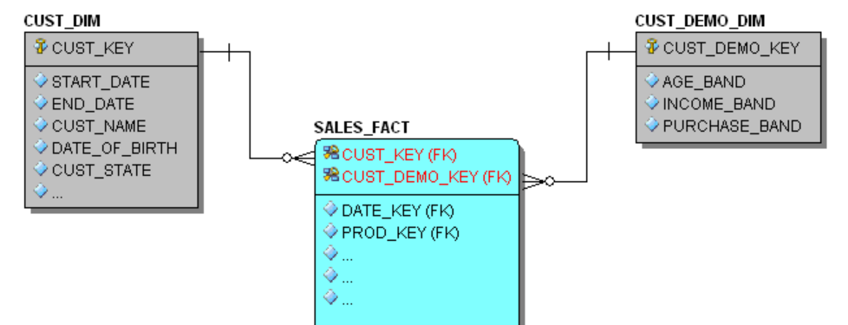
Example of Type 4 SCD – Part 3

Slide 34
Type 6 SCD – Part 1
Its a hybrid approach, a combination of all three basic SCD techniques, hence its named 1+2+3 = 6 !!!!
Type 6 is particularly applicable if you want to maintain complete history like Type 2 and would also like to have an easy way to effect on current version like Type 3, and for certain non important column directly overriding like Type 1

Slide 35
Type 6 SCD – Part 2
Type 2 : To track the historical changes as they occur.
Type 3 : To include the "Current" attribute.
Type 1 : Type 3 attribute is updated as Type 1 attribute or some columns directly having Type 1 treatment.

Slide 36
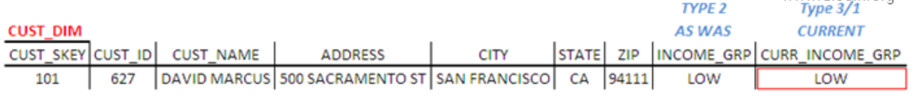
Example of Type 6 SCD – Part 1
Lets see consider Customer Dimension, which is modeled as Type 6.
This dimension will have two INCOME GROUP attributes, one to capture current and other to capture the historical changes.
Initially the customer is in LOW income group, so both income attributes have the same values.

Slide 37
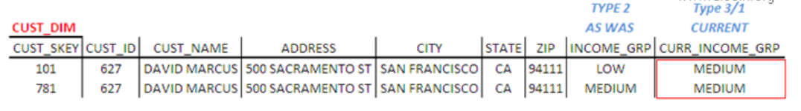
Example of Type 6 SCD – Part 2
When the customer's income group is changed, a new dimension record is added to keep the historical changes for the customer. In the new dimension record current income group will be identical to income group. For all previous instances of customer dimension rows, the current income attribute will be overwritten to reflect the latest value.

Slide 38
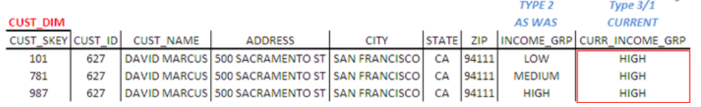
Example of Type 6 SCD – Part 3
Subsequent changes are also treated the same.
With this hybrid approach, we issue a new row to capture the change (type 2) and add a new column to track the current assignment (type 3), where subsequent changes are handled as a type 1 response.

Slide 39
When to use SCD Type 6
Data warehousing teams are quite often asked to preserve historical attributes, while also supporting the ability to report historical performance data according to current attribute values. SCD Type 6 is the answer for such requirements.
If you want to see the historical facts based on the current attribute values, we will filter or summarize on the current attributes. If we summarize on the historical attribute, we will see facts as they sum up at a point of time.
Here is our Customer Dimension example, we can use INCOME_GRP column to see the facts values at a point of time and CURR_INCOME_GRP to get the historical fact values based on the current attribute value.

